Slide 1
Particle photon weather station Part 1 of 6: Overview & Event Hub Setup
Particle Photon + DHT11 Sensor + Azure + Power BI + Node.js + .NET = AWESOME

Slide 2
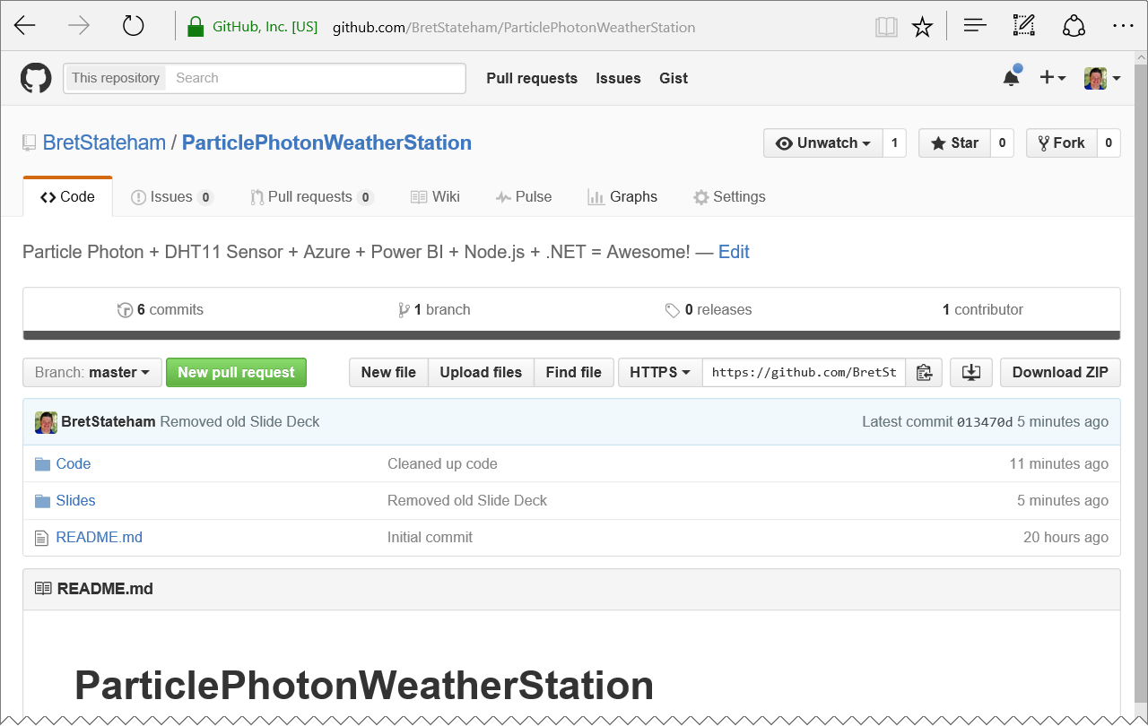
Grab the slides & code:
http://aka.ms/ppws

Slide 3
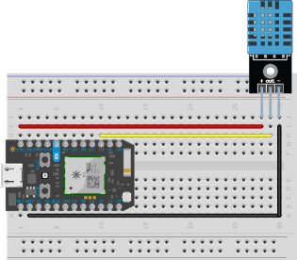
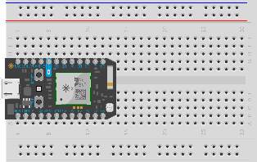
Solution ARCHITECTURE
<name>data
Power BI Data Set
Send
<name>job
Stream Analytics Job
<name>ns Service Bus Namespace
Receive
Logging
<name>hub
Event Hub
<name>storage
Storage Account
SEND
PublishToEventHub Webhook
Receive
Receive
ChkPt
“NodeReceiver”
Node.JS Receiver App
“DotNetReceiver”
.NET C# Console App Receiver

Slide 4
<name>data
Power BI Data Set
Send
<name>job
Stream Analytics Job
<name>ns Service Bus Namespace
Receive
Logging
<name>hub
Event Hub
<name>storage
Storage Account
SEND
PublishToEventHub Webhook
Receive
Receive
ChkPt
“NodeReceiver”
Node.JS Receiver App
“DotNetReceiver”
.NET C# Console App Receiver

Slide 5
ppwsbssdata
Power BI Data Set
Send
ppwsbssjob
Stream Analytics Job
ppwsbssns Service Bus Namespace
Receive
Logging
ppwsbsshub
Event Hub
ppwsbssstorage
Storage Account
SEND
PublishToEventHub Webhook
Receive
Receive
ChkPt
“NodeReceiver”
Node.JS Receiver App
“DotNetReceiver”
.NET C# Console App Receiver

Slide 6
Solution ARCHITECTURE
<name>ns Service Bus Namespace
<name>hub
Event Hub

Slide 7
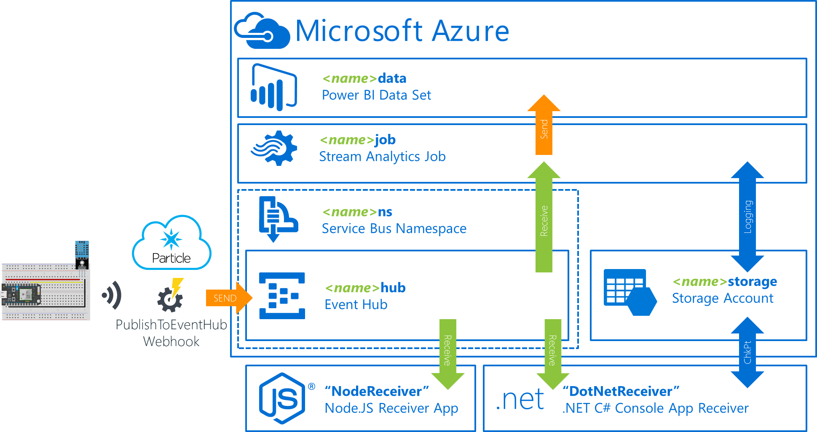
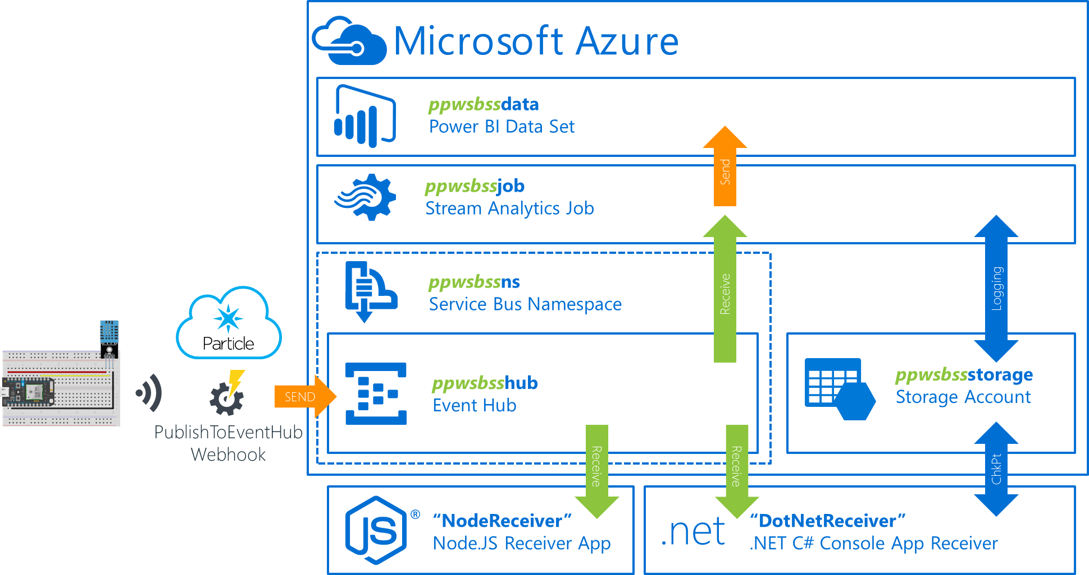
Coming up with a good <name>
It’s recommended that you use a consistent prefix when you name your objects in Azure
Many names need to be globally unique. Plus, a good prefix makes it easier to identify them, determine their role, and delete them later when you need to clean up.
The prefix is identified by the “<name>” placeholders in the architecture diagram.
I recommend using something like “ppws” (short for ParticlePhotonWeatherStation) and your initials. For example, for me
“ppwsbss”

Slide 8
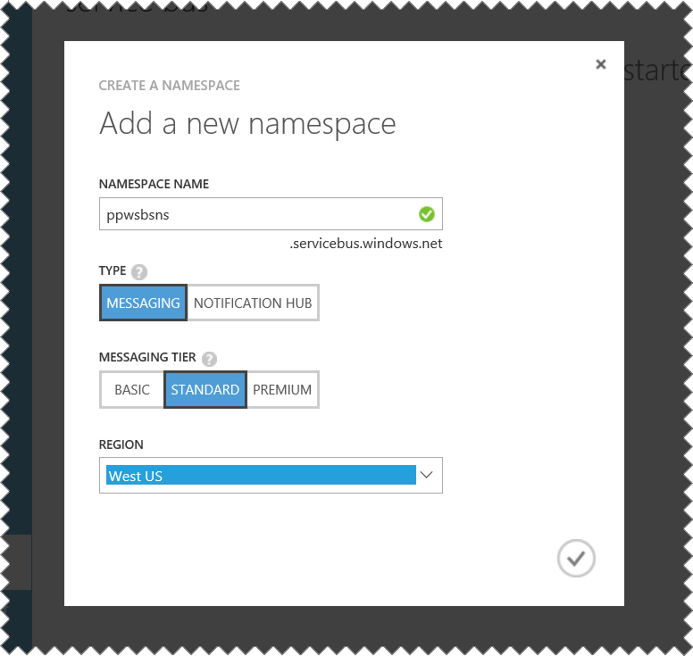
Using the same region
As you provision your resources in Azure you should use the same region for all of them.
This will decrease latency between them as well as reduce costs by eliminating data leaving one region as it travels to another.

Slide 9
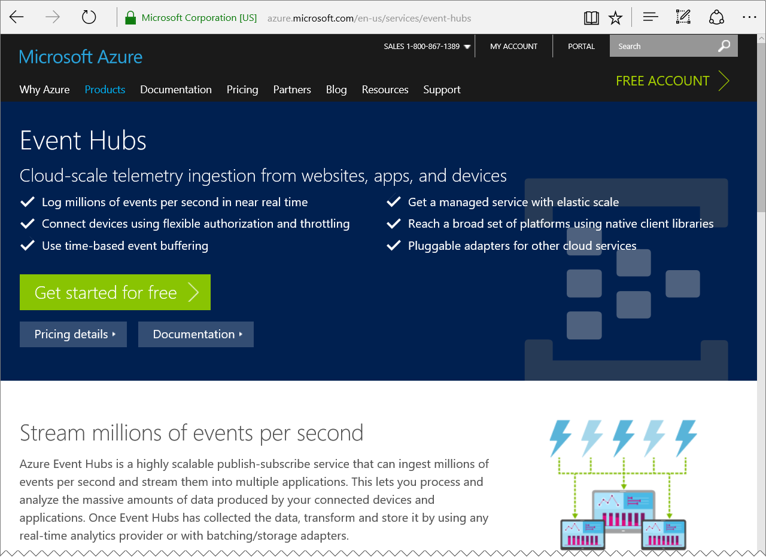
Azure event hubs
“Azure Event Hubs is a highly scalable publish-subscribe service that can ingest millions of events per second and stream them into multiple applications.”
Learn more here:
https://azure.microsoft.com/services/event-hubs/

Slide 10
Create the Azure Event Hub

Slide 11
Solution ARCHITECTURE
<name>ns Service Bus Namespace
<name>hub
Event Hub

Slide 12
Solution ARCHITECTURE
<name>ns Service Bus Namespace
<name>hub
Event Hub

Slide 13
Particle photon weather station Part 2 of 6: Particle Cloud and photon Prep
Particle Photon + DHT11 Sensor + Azure + Power BI + Node.js + .NET = AWESOME

Slide 14
Grab the slides & code:
http://aka.ms/ppws

Slide 15
Solution ARCHITECTURE
<name>data
Power BI Data Set
Send
<name>job
Stream Analytics Job
<name>ns Service Bus Namespace
Receive
Logging
<name>hub
Event Hub
<name>storage
Storage Account
SEND
PublishToEventHub Webhook
Receive
Receive
ChkPt
“NodeReceiver”
Node.JS Receiver App
“DotNetReceiver”
.NET C# Console App Receiver

Slide 16
Solution ARCHITECTURE
<name>ns Service Bus Namespace
<name>hub
Event Hub

Slide 17
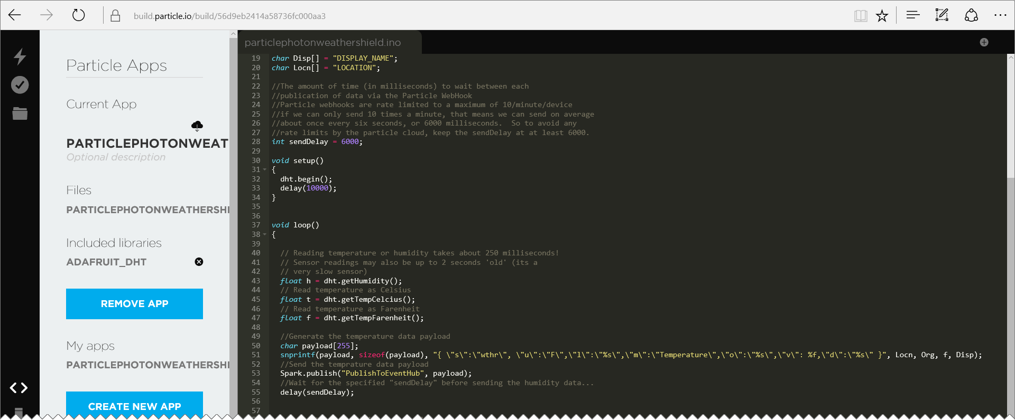
Particle “BUILD” browser IDE
https://build.particle.io

Slide 18
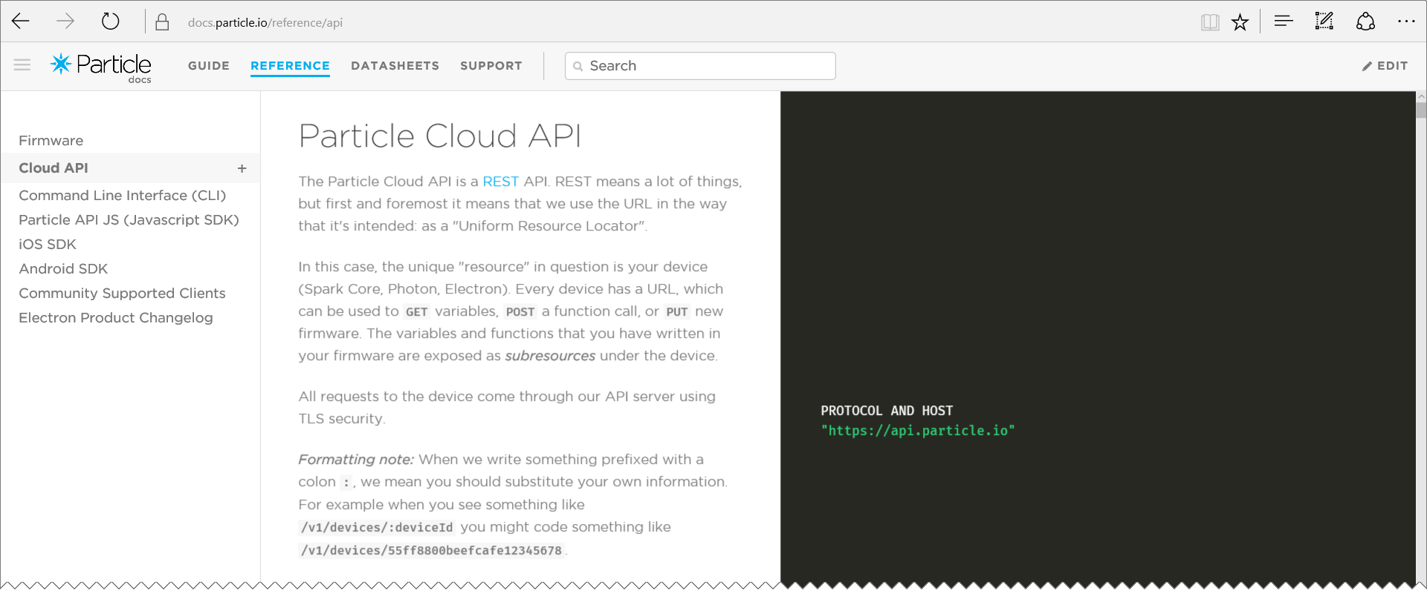
The particle cloud
https://docs.particle.io/reference/api/

Slide 19
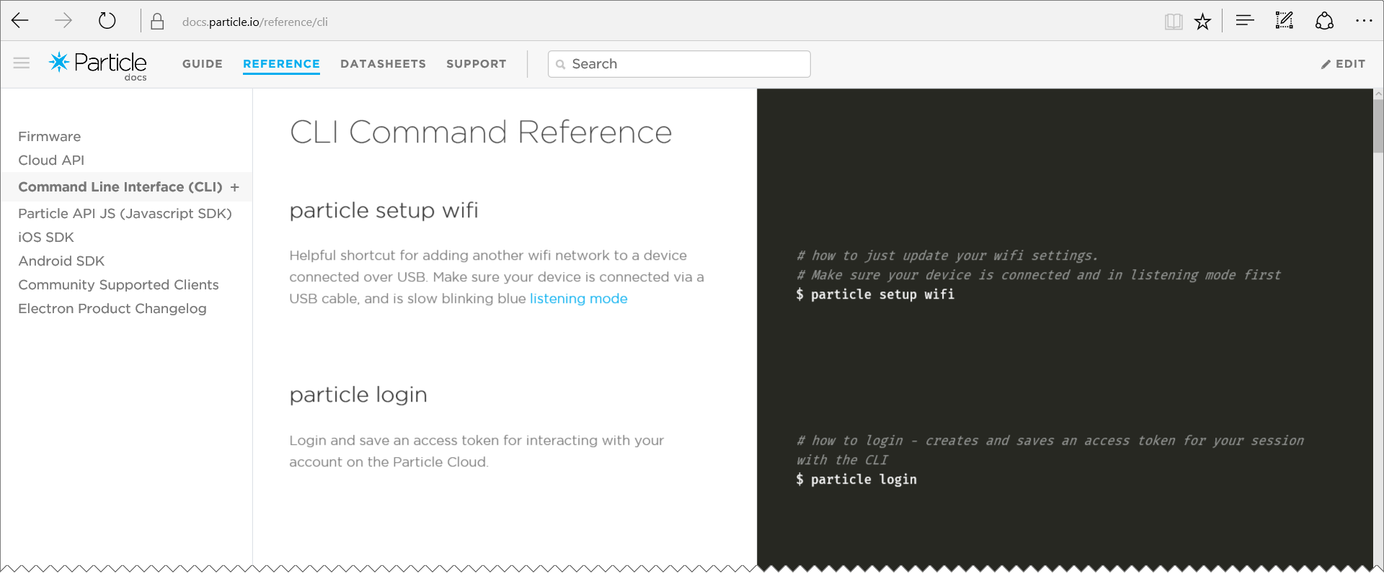
The particle-CLI
https://docs.particle.io/reference/cli/
REQUIRES NODE.JS

Slide 20
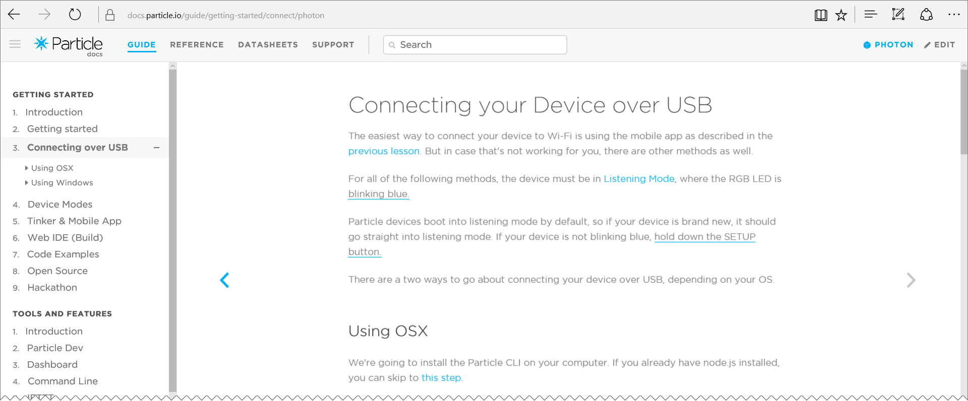
Claiming your Photon
https://docs.particle.io/guide/getting-started

Slide 21
Particle-cli login
You need to login to your particle cloud account from the cli (use your particle cloud login email and password): particle login
Of course you can also logout (provide your particle cloud password to completely logout): particle logout

Slide 22
Identify the attached photon
First find the COM port it is attached to: particle serial list
Then, get the device ID: particle serial identify <COM#>
Copy the Photon ID to your clipboard and save somewhere for later
PHOTON CONNECTED VIA USB AND IN LISTENING MODE
(Blinking blue)

Slide 23
Configure the particle wifi
From the command prompt: particle setup wifi Follow the prompts to connect the WiFi: <your wifi ssid> <your wifi security mode> <your wifi cypher type> <your wifi password>
PHOTON CONNECTED VIA USB AND IN LISTENING MODE
(Blinking blue)

Slide 24
Claim and name your photon
Add the device to your account particle device add <id>
Name the device particle device rename <id> <newname>
PHOTON ONLINE (BREATHING CYAN)

Slide 25
Configure the Particle Cloud and Photon

Slide 26
Solution ARCHITECTURE
<name>ns Service Bus Namespace
<name>hub
Event Hub

Slide 27
Solution ARCHITECTURE
<name>ns Service Bus Namespace
SEND
<name>hub
Event Hub
PublishToEventHub Webhook

Slide 28
Particle photon weather station Part 3 of 6: Photon DHT11 Circuit & WeBHOOK & CODE
Particle Photon + DHT11 Sensor + Azure + Power BI + Node.js + .NET = AWESOME

Slide 29
Grab the slides & code:
http://aka.ms/ppws

Slide 30
Solution ARCHITECTURE
<name>data
Power BI Data Set
Send
<name>job
Stream Analytics Job
<name>ns Service Bus Namespace
Receive
Logging
<name>hub
Event Hub
<name>storage
Storage Account
SEND
PublishToEventHub Webhook
Receive
Receive
ChkPt
“NodeReceiver”
Node.JS Receiver App
“DotNetReceiver”
.NET C# Console App Receiver

Slide 31
Solution ARCHITECTURE
<name>ns Service Bus Namespace
SEND
<name>hub
Event Hub
PublishToEventHub Webhook

Slide 32
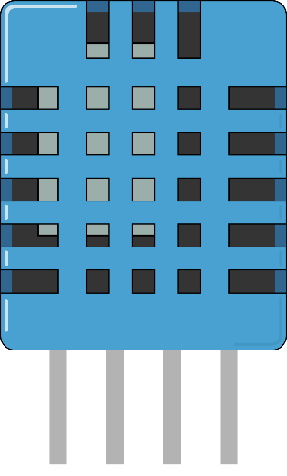
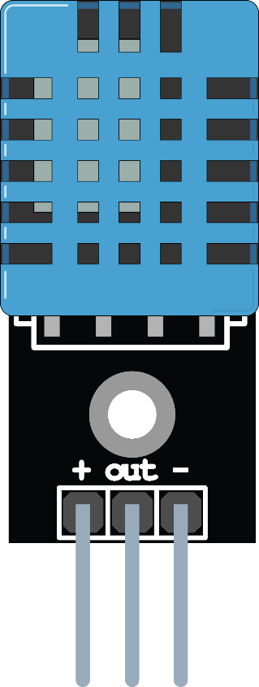
TWO TYPES OF DHT11 SENSORS
Standalone 4 Pin Sensor
(Requires external data line pullup resistor)
Pre-configured 3 Pin Sensor (Pullup resistor pre-installed on board)
Vcc
Gnd
Data
Not Used
Vcc
Gnd
Data

Slide 33
Standalone sensor pullup resistor
10KΩ
Vcc
Gnd
Data
Not Used

Slide 34
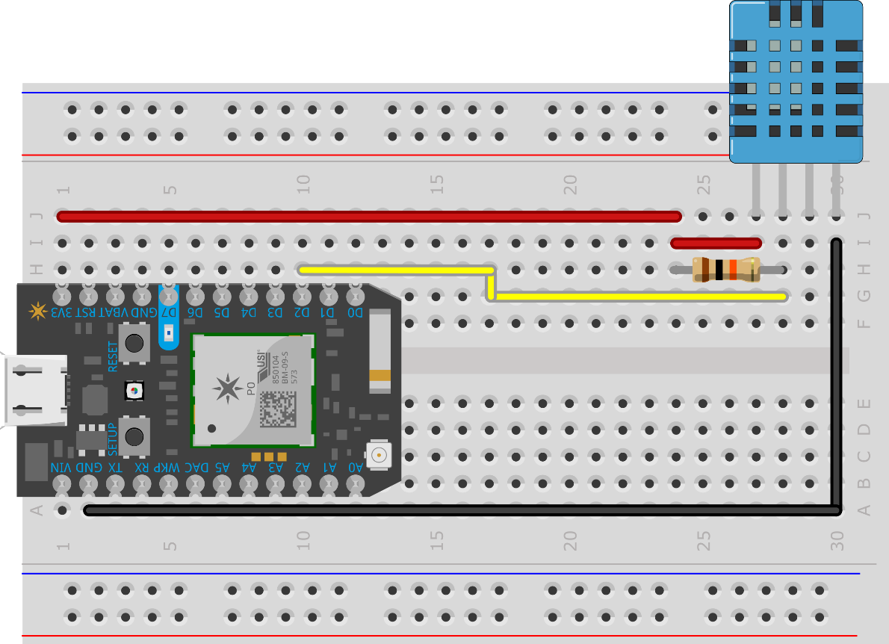
Standalone DHT11 CIRCUIT
10kΩ Pullup resistor Between the vcc pin and
the data pin

Slide 35
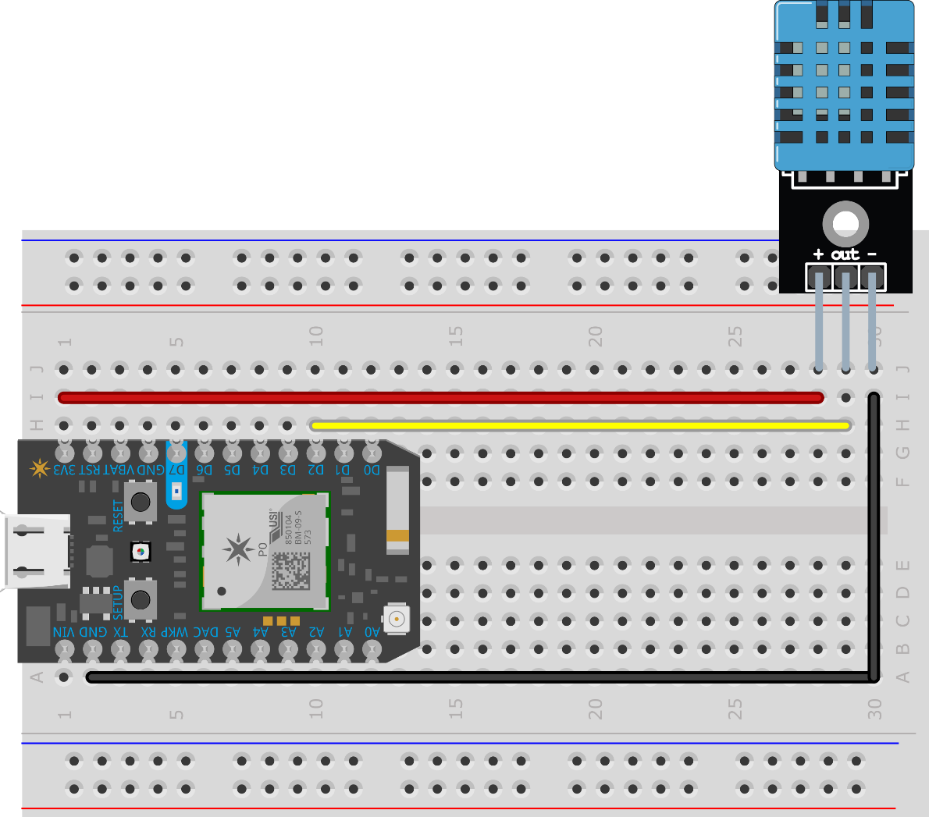
Pre-configured sensor circuit

Slide 36

Both use the same photon pins
PHOTON | DHT11
3V3 | Vcc
D2 | Data
GND | GND

Slide 37
Creating the Photon and DHT11 Circuit

Slide 38
CORRECTION - SPARK becomes PARTICLE
In May of 2015, “Spark” (the makers of the Photon) was renamed to “Particle”
That has some impact on the code, the Spark object that was used in code to access the Particle Cloud has been renamed to Particle instead. Makes sense.
Many of the upcoming slides, as well as the source code demoed reference the old Spark name. It still works, but has been deprecated. You should use the Particle object moving forward.
The slides and source in the http://aka.ms/ppws repo have been updated to use the new name as well, I just didn’t take the time to re-record the video.

Slide 39
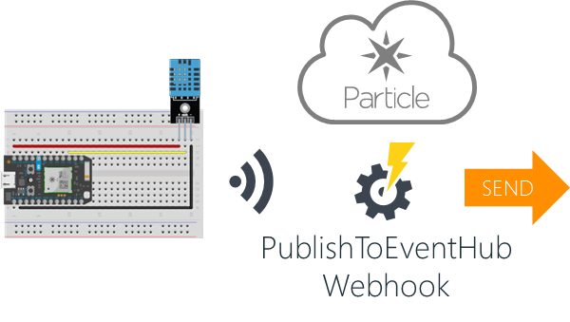
Understanding the webhook
Webhook.json
{
"event": "PublishToEventHub",
"url": "https://<YOUR_SERVICEBUS_NAME>.servicebus.windows.net/<YOUR_EVENTHUB_NAME>/messages",
"requestType": "POST",
"json": {
"subject": "{{s}}",
"unitofmeasure": "{{u}}",
"measurename": "{{m}}",
"value": "{{v}}",
"organization": "{{o}}",
"displayname": "{{d}}",
"location": "{{l}}",
"timecreated": "{{SPARK_PUBLISHED_AT}}",
"guid": "{{SPARK_CORE_ID}}"
},
"azure_sas_token": {
"key_name": "<YOUR_SAS_POLICY_NAME>",
"key": "<YOUR_SAS_POLICY_KEY>"
},
"mydevices": true
}

Slide 40
{
"event": "PublishToEventHub",
"url": "https://<YOUR_SERVICEBUS_NAME>.servicebus.windows.net/<YOUR_EVENTHUB_NAME>/messages",
"requestType": "POST",
"json": {
"subject": "{{s}}",
"unitofmeasure": "{{u}}",
"measurename": "{{m}}",
"value": "{{v}}",
"organization": "{{o}}",
"displayname": "{{d}}",
"location": "{{l}}",
"timecreated": "{{SPARK_PUBLISHED_AT}}",
"guid": "{{SPARK_CORE_ID}}"
},
"azure_sas_token": {
"key_name": "<YOUR_SAS_POLICY_NAME>",
"key": "<YOUR_SAS_POLICY_KEY>"
},
"mydevices": true
}

Slide 41
{
"event": "PublishToEventHub",
"url": "https://<YOUR_SERVICEBUS_NAME>.servicebus.windows.net/<YOUR_EVENTHUB_NAME>/messages",
"requestType": "POST",
"json": {
"subject": "{{s}}",
"unitofmeasure": "{{u}}",
"measurename": "{{m}}",
"value": "{{v}}",
"organization": "{{o}}",
"displayname": "{{d}}",
"location": "{{l}}",
"timecreated": "{{SPARK_PUBLISHED_AT}}",
"guid": "{{SPARK_CORE_ID}}"
},
"azure_sas_token": {
"key_name": "<YOUR_SAS_POLICY_NAME>",
"key": "<YOUR_SAS_POLICY_KEY>"
},
"mydevices": true
}
The name of the “event” that will invoke the webhook.
When you call Particle.publish(“PublishToEventHub", payload); from your Photon, the Particle cloud back end will trigger this webhook and publish your payload to the Azure Event Hub, specified by the “url”

Slide 42
{
"event": "PublishToEventHub",
"url": "https://<YOUR_SERVICEBUS_NAME>.servicebus.windows.net/<YOUR_EVENTHUB_NAME>/messages",
"requestType": "POST",
"json": {
"subject": "{{s}}",
"unitofmeasure": "{{u}}",
"measurename": "{{m}}",
"value": "{{v}}",
"organization": "{{o}}",
"displayname": "{{d}}",
"location": "{{l}}",
"timecreated": "{{SPARK_PUBLISHED_AT}}",
"guid": "{{SPARK_CORE_ID}}"
},
"azure_sas_token": {
"key_name": "<YOUR_SAS_POLICY_NAME>",
"key": "<YOUR_SAS_POLICY_KEY>"
},
"mydevices": true
}
The “url” of the Azure Event Hub that the data will be published to.
You will need to enter your own Service Bus namespace and event hub names in place of the <YOUR_SERVICEBUS_NAME> and <YOUR_EVENTHUB_NAME> placeholders

Slide 43
{
"event": "PublishToEventHub",
"url": "https://<YOUR_SERVICEBUS_NAME>.servicebus.windows.net/<YOUR_EVENTHUB_NAME>/messages",
"requestType": "POST",
"json": {
"subject": "{{s}}",
"unitofmeasure": "{{u}}",
"measurename": "{{m}}",
"value": "{{v}}",
"organization": "{{o}}",
"displayname": "{{d}}",
"location": "{{l}}",
"timecreated": "{{SPARK_PUBLISHED_AT}}",
"guid": "{{SPARK_CORE_ID}}"
},
"azure_sas_token": {
"key_name": "<YOUR_SAS_POLICY_NAME>",
"key": "<YOUR_SAS_POLICY_KEY>"
},
"mydevices": true
}
The data will be sent to the url using an HTTP POST

Slide 44
{
"event": "PublishToEventHub",
"url": "https://<YOUR_SERVICEBUS_NAME>.servicebus.windows.net/<YOUR_EVENTHUB_NAME>/messages",
"requestType": "POST",
"json": {
"subject": "{{s}}",
"unitofmeasure": "{{u}}",
"measurename": "{{m}}",
"value": "{{v}}",
"organization": "{{o}}",
"displayname": "{{d}}",
"location": "{{l}}",
"timecreated": "{{SPARK_PUBLISHED_AT}}",
"guid": "{{SPARK_CORE_ID}}"
},
"azure_sas_token": {
"key_name": "<YOUR_SAS_POLICY_NAME>",
"key": "<YOUR_SAS_POLICY_KEY>"
},
"mydevices": true
}
The json template is used to create the data for the message that will be sent to the Azure Event Hub

Slide 45
{
"event": "PublishToEventHub",
"url": "https://<YOUR_SERVICEBUS_NAME>.servicebus.windows.net/<YOUR_EVENTHUB_NAME>/messages",
"requestType": "POST",
"json": {
"subject": "{{s}}",
"unitofmeasure": "{{u}}",
"measurename": "{{m}}",
"value": "{{v}}",
"organization": "{{o}}",
"displayname": "{{d}}",
"location": "{{l}}",
"timecreated": "{{SPARK_PUBLISHED_AT}}",
"guid": "{{SPARK_CORE_ID}}"
},
"azure_sas_token": {
"key_name": "<YOUR_SAS_POLICY_NAME>",
"key": "<YOUR_SAS_POLICY_KEY>"
},
"mydevices": true
}
{
“s”: ”wthr”,
“u”: “F”,
“m”: “Temperature”,
“v”: 79.234,
“o”: “WearHacks LA”,
“d”: “Brets Demo Photon” “l”: “LA”,
} Sample Payload from the Photon’s Spark.Publish call

Slide 46
{
"event": "PublishToEventHub",
"url": "https://<YOUR_SERVICEBUS_NAME>.servicebus.windows.net/<YOUR_EVENTHUB_NAME>/messages",
"requestType": "POST",
"json": {
"subject": "{{s}}",
"unitofmeasure": "{{u}}",
"measurename": "{{m}}",
"value": "{{v}}",
"organization": "{{o}}",
"displayname": "{{d}}",
"location": "{{l}}",
"timecreated": "{{SPARK_PUBLISHED_AT}}",
"guid": "{{SPARK_CORE_ID}}"
},
"azure_sas_token": {
"key_name": "<YOUR_SAS_POLICY_NAME>",
"key": "<YOUR_SAS_POLICY_KEY>"
},
"mydevices": true
}
The values:
SPARK_PUBLISHED_AT and SPARK_CORE_ID
Are supplied by the Particle cloud back end

Slide 47
{
"event": "PublishToEventHub",
"url": "https://<YOUR_SERVICEBUS_NAME>.servicebus.windows.net/<YOUR_EVENTHUB_NAME>/messages",
"requestType": "POST",
"json": {
"subject": "{{s}}",
"unitofmeasure": "{{u}}",
"measurename": "{{m}}",
"value": "{{v}}",
"organization": "{{o}}",
"displayname": "{{d}}",
"location": "{{l}}",
"timecreated": "{{SPARK_PUBLISHED_AT}}",
"guid": "{{SPARK_CORE_ID}}"
},
"azure_sas_token": {
"key_name": "<YOUR_SAS_POLICY_NAME>",
"key": "<YOUR_SAS_POLICY_KEY>"
},
"mydevices": true
}
The Shared-Access-Signature key name, and key value used to access the Azure Event Hub

Slide 48
{
"event": "PublishToEventHub",
"url": "https://<YOUR_SERVICEBUS_NAME>.servicebus.windows.net/<YOUR_EVENTHUB_NAME>/messages",
"requestType": "POST",
"json": {
"subject": "{{s}}",
"unitofmeasure": "{{u}}",
"measurename": "{{m}}",
"value": "{{v}}",
"organization": "{{o}}",
"displayname": "{{d}}",
"location": "{{l}}",
"timecreated": "{{SPARK_PUBLISHED_AT}}",
"guid": "{{SPARK_CORE_ID}}"
},
"azure_sas_token": {
"key_name": "<YOUR_SAS_POLICY_NAME>",
"key": "<YOUR_SAS_POLICY_KEY>"
},
"mydevices": true
}
Restricts the webhook to being triggered only from events published from your own devices

Slide 49
Create the particle webhook
From the command prompt, get in the same folder as the webhook.json file you downloaded, and run: particle webhook create webhook.json
Other particle-cli webhook commands include: particle webhook list particle webhook delete hookid

Slide 50
Creating the Webhook

Slide 51
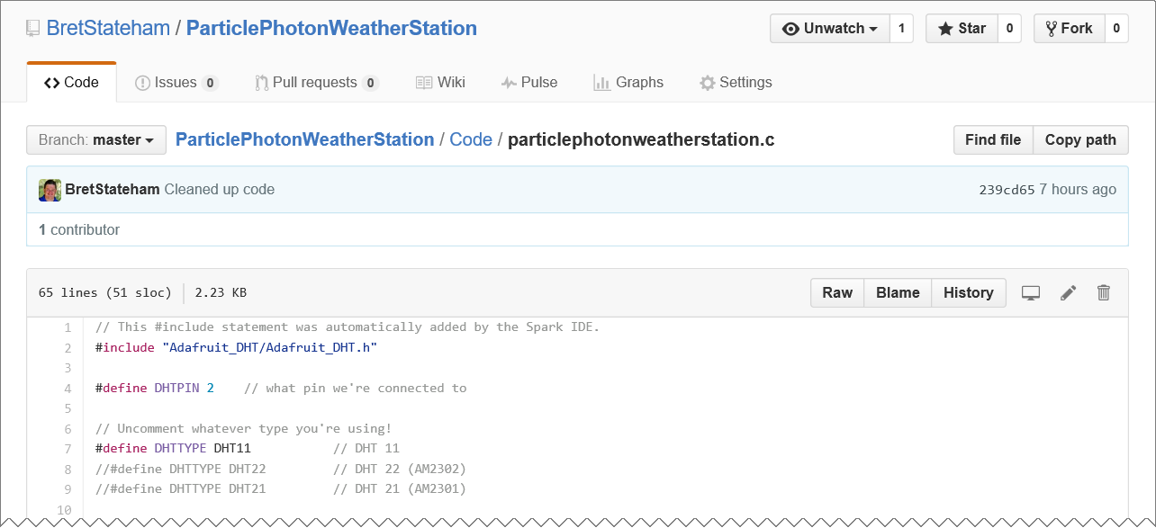
Groking the code

Slide 52
Groking the photon code
// This #include statement was automatically added by the Spark IDE.
#include "Adafruit_DHT/Adafruit_DHT.h"
#define DHTPIN 2 // what pin we're connected to
// Uncomment whatever type you're using!
#define DHTTYPE DHT11// DHT 11
//...snip...
DHT dht(DHTPIN, DHTTYPE);

Slide 53
Groking the photon code
char Org[] = "ORGANIZATION_NAME";
char Disp[] = "DISPLAY_NAME";
char Locn[] = "LOCATION";
//The amount of time (in milliseconds) to wait between each
//publication of data via the Particle WebHook
//Particle webhooks are rate limited to a maximum of 10/minute/device
//if we can only send 10 times a minute, that means we can send on average
//about once every six seconds, or 6000 milliseconds. So to avoid any
//rate limits by the particle cloud, keep the sendDelay at at least 6000.
int sendDelay = 6000;

Slide 54
Groking the photon code
void setup()
{
dht.begin();
delay(10000);
}

Slide 55
Groking the photon code
void loop()
{
// Reading temperature or humidity takes about 250 milliseconds!
// Sensor readings may also be up to 2 seconds 'old' (its a
// very slow sensor)
float h = dht.getHumidity();
// Read temperature as Celsius
float t = dht.getTempCelcius();
// Read temperature as Farenheit
float f = dht.getTempFarenheit();

Slide 56
Groking the photon code
//Generate the temperature data payload
char payload[255];
snprintf(payload, sizeof(payload), "{ \"s\":\"wthr\", \"u\":\"F\", \"m\":\"Temperature\", \"v\": %f, \"o\":\"%s\", \"d\":\"%s\“,
\"l\":\"%s\"}",
f, Org, Disp, Locn);
//Send the temperature data payload
Particle.publish("PublishToEventHub", payload);
//Wait for the specified "sendDelay" before sending the humidity data...
delay(sendDelay);
{
“s”: ”wthr”,
“u”: “F”,
“m”: “Temperature”,
“v”: 79.234,
“o”: “ORGANIZATION_NAME”,
“d”: “DISPLAY_NAME” “l”: “LOCATION”,
}

Slide 57
Groking the photon code
//Generate the humidity data payload
snprintf(payload, sizeof(payload), "{ \"s\":\"wthr\", \"u\":\"%%\", \"m\":\" Humidity \", \"v\": %f, \"o\":\"%s\", \"d\":\"%s\“,
\"l\":\"%s\"}",
h, Org, Disp, Locn);
//Send the humidity data payload
Particle.publish("PublishToEventHub", payload);
//wait for the specified "sendDelay" before looping...
delay(sendDelay);
}
{
“s”: ”wthr”,
“u”: “%”,
“m”: “Humidity”,
“v”: 60,
“o”: “ORGANIZATION_NAME”,
“d”: “DISPLAY_NAME” “l”: “LOCATION”,
}

Slide 58
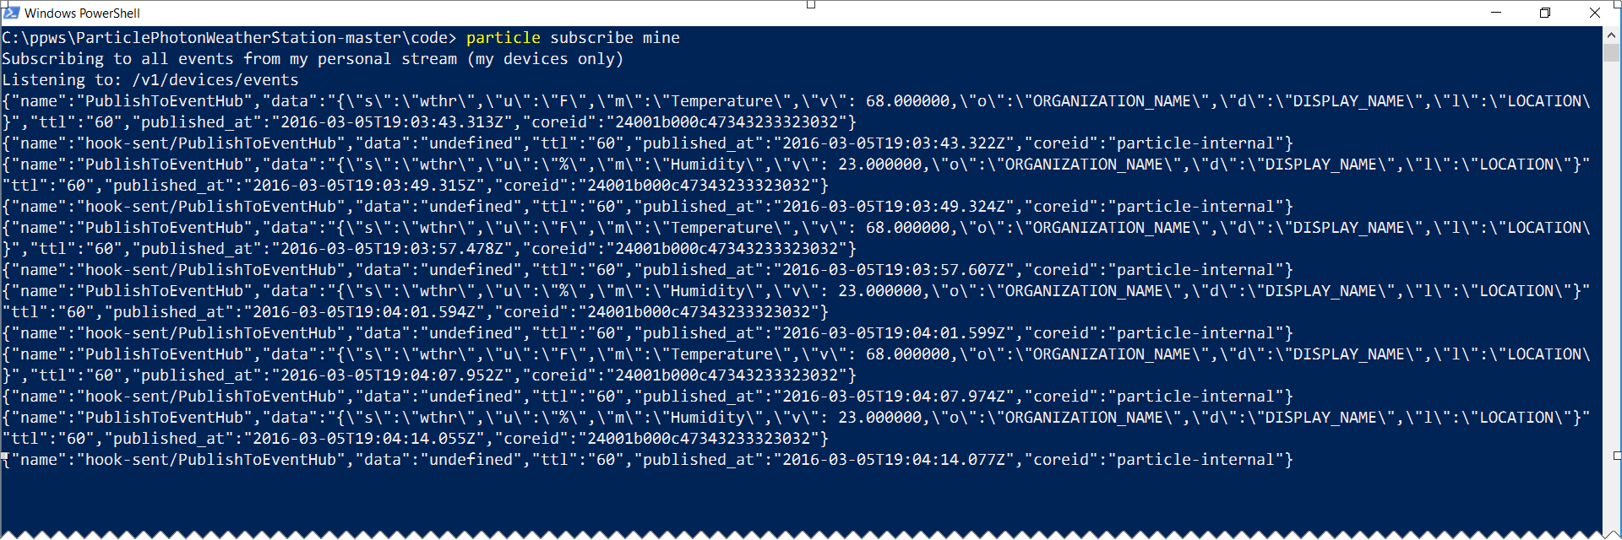
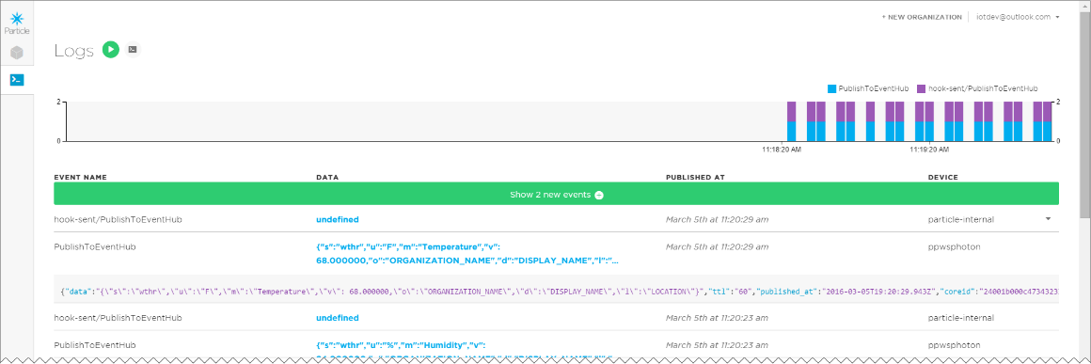
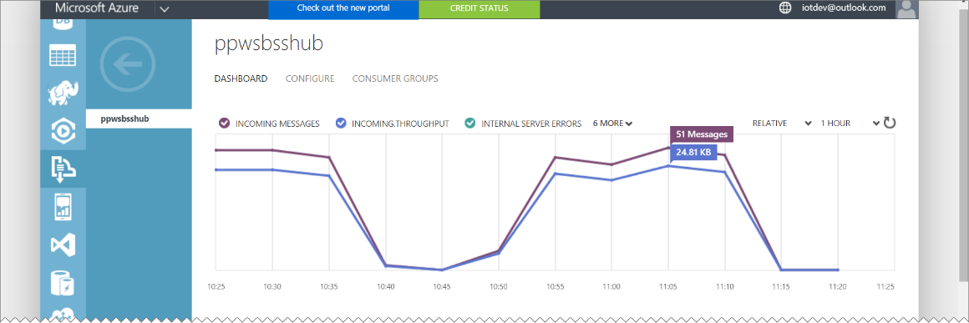
Monitoring your photon
Particle-cli: particle subscribe mine
Particle Dashboard: http://dashboard.particle.io/user/logs
Azure Portal: https://manage.windowsazure.com

Slide 59
Deploying the code

Slide 60
Solution ARCHITECTURE
<name>ns Service Bus Namespace
SEND
<name>hub
Event Hub
PublishToEventHub Webhook

Slide 61
Solution ARCHITECTURE
<name>data
Power BI Data Set
Send
<name>job
Stream Analytics Job
<name>ns Service Bus Namespace
Receive
Logging
<name>hub
Event Hub
<name>storage
Storage Account
SEND
PublishToEventHub Webhook

Slide 62
Particle photon weather station Part 4 0f 6: Reporting with Power BI
Particle Photon + DHT11 Sensor + Azure + Power BI + Node.js + .NET = AWESOME

Slide 63
Grab the slides & code:
http://aka.ms/ppws

Slide 64
Solution ARCHITECTURE
<name>data
Power BI Data Set
Send
<name>job
Stream Analytics Job
<name>ns Service Bus Namespace
Receive
Logging
<name>hub
Event Hub
<name>storage
Storage Account
SEND
PublishToEventHub Webhook
Receive
Receive
ChkPt
“NodeReceiver”
Node.JS Receiver App
“DotNetReceiver”
.NET C# Console App Receiver

Slide 65
Solution ARCHITECTURE
<name>data
Power BI Data Set
Send
<name>job
Stream Analytics Job
<name>ns Service Bus Namespace
Receive
Logging
<name>hub
Event Hub
<name>storage
Storage Account
SEND
PublishToEventHub Webhook

Slide 66
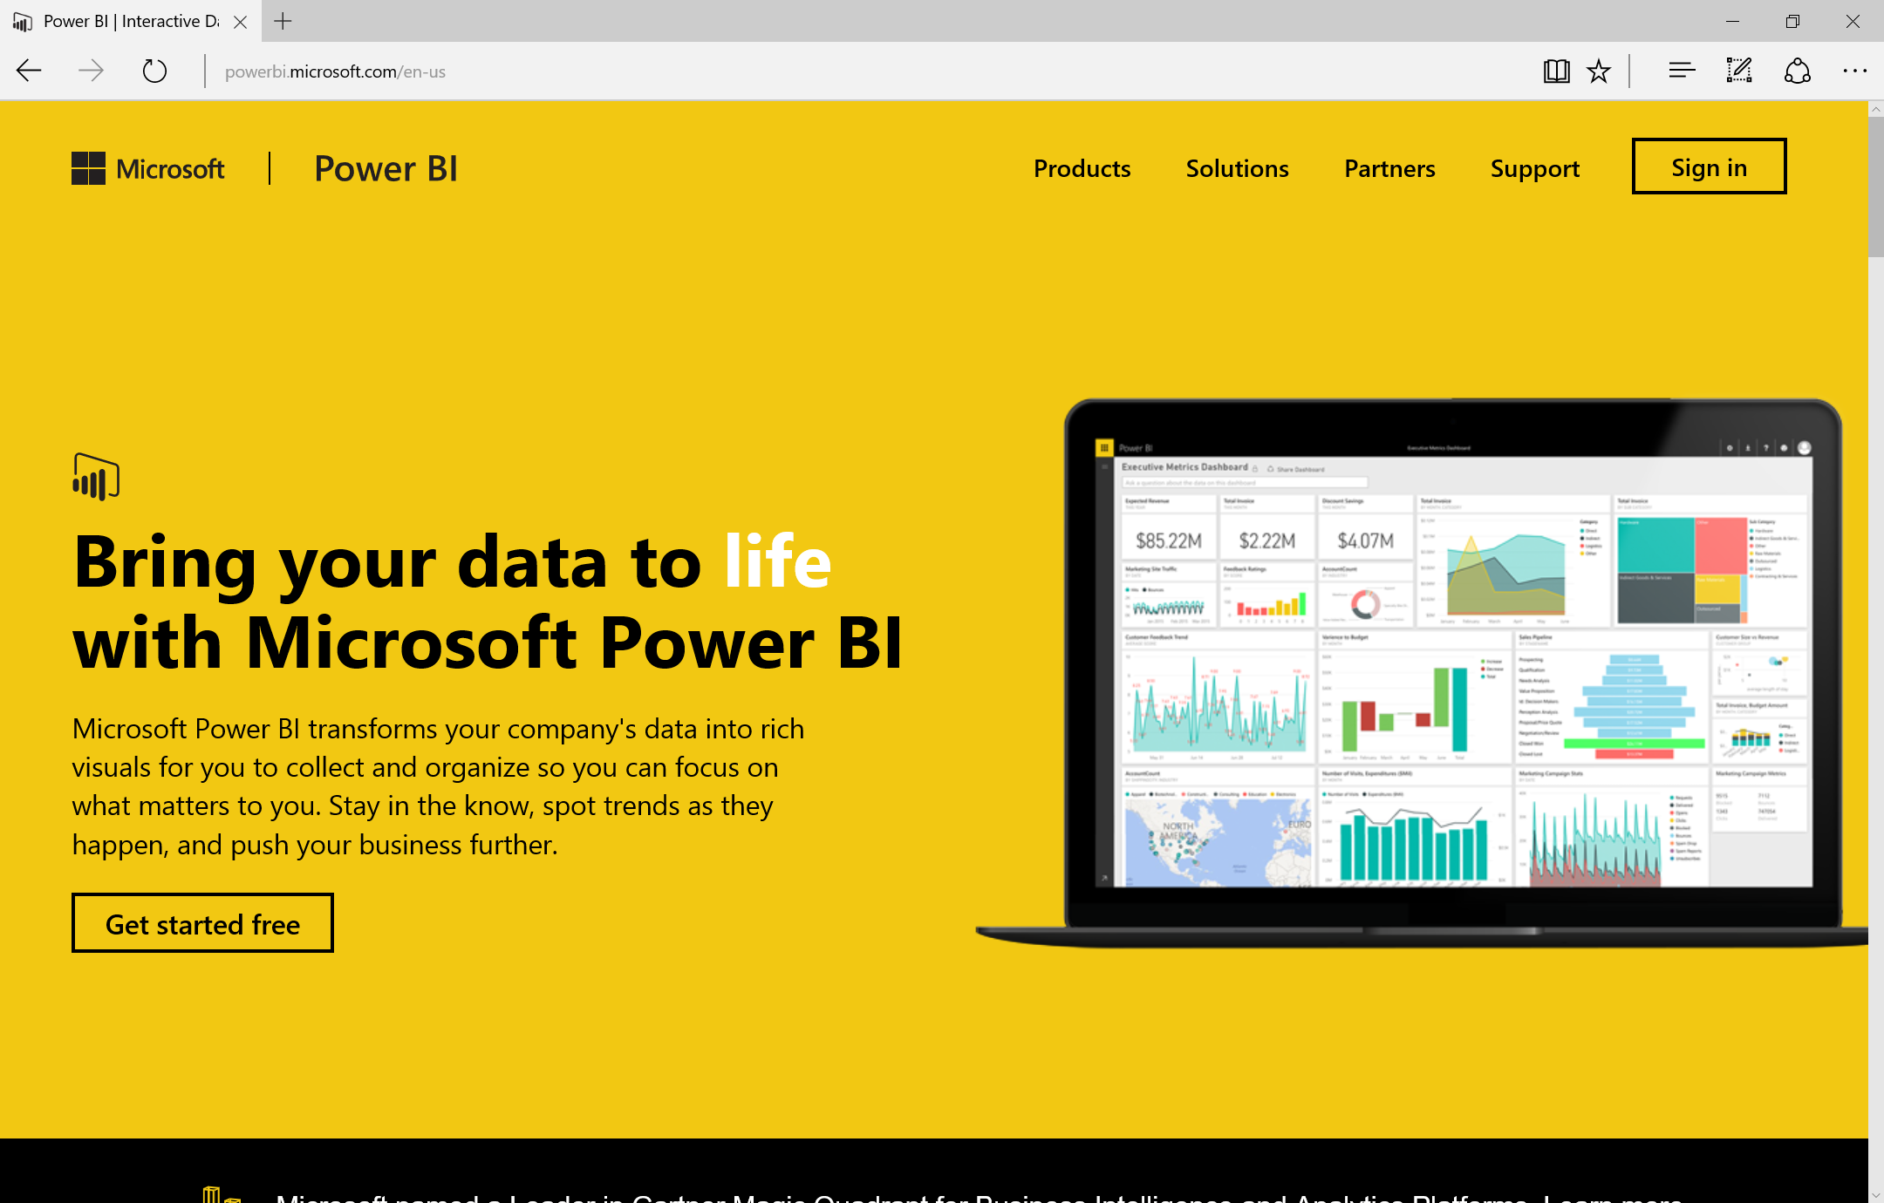
WHAT IS POWER BI?
Online Service for creating and sharing data sets, visualizations, reports and dashboards both within your organization as well as with others.

Slide 67
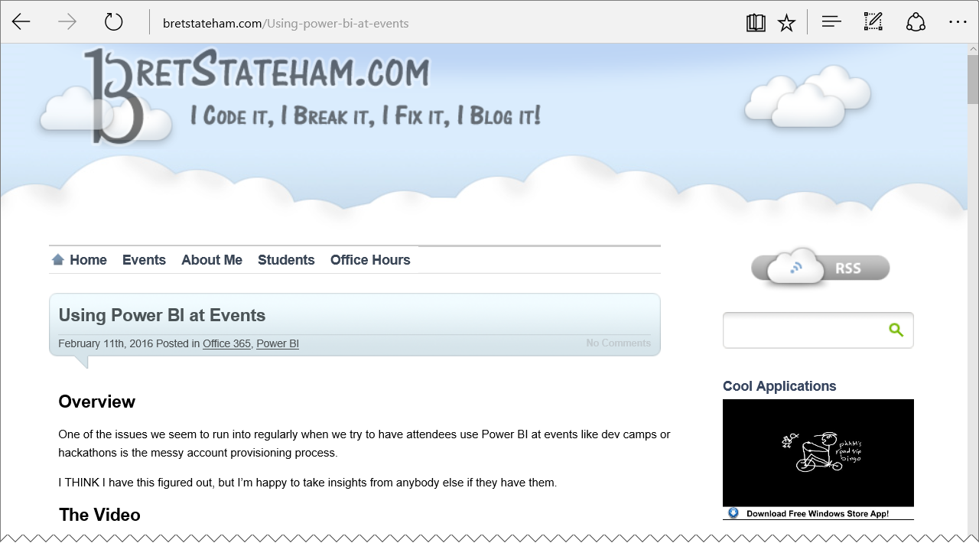
Signing up for power bi
You need an “organizational email” to sign up for Power BI.
You can’t use outlook.com, gmail.com, etc. personal accounts
Check out my blog post or Channel 9 video for more information
http://BretStateham.com/Using-power-bi-at-events

Slide 68
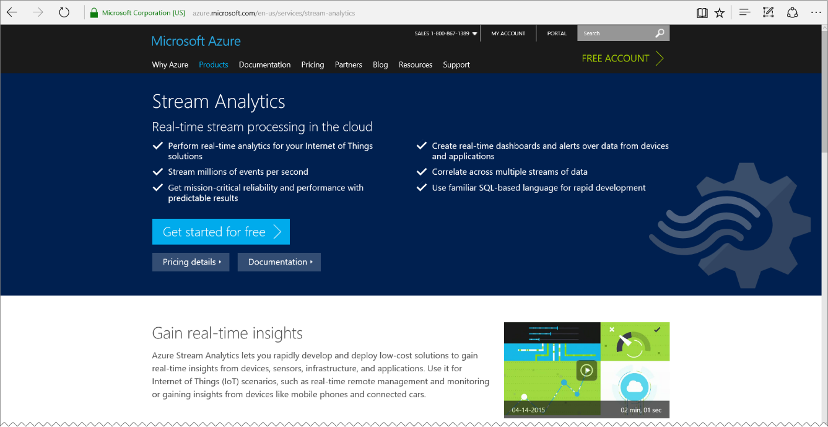
Stream analytics
Stream Analytics is integrated out-of-the-box with Azure Event Hubs to ingest millions of events per second. Stream Analytics processes ingested events in real-time, comparing multiple streams or comparing streams with historical values and models. It detects anomalies, transforms incoming data, triggers an alert when a specific error or condition appears in the stream, and displays this real-time data in your dashboard.
https://azure.microsoft.com/services/stream-analytics/

Slide 69
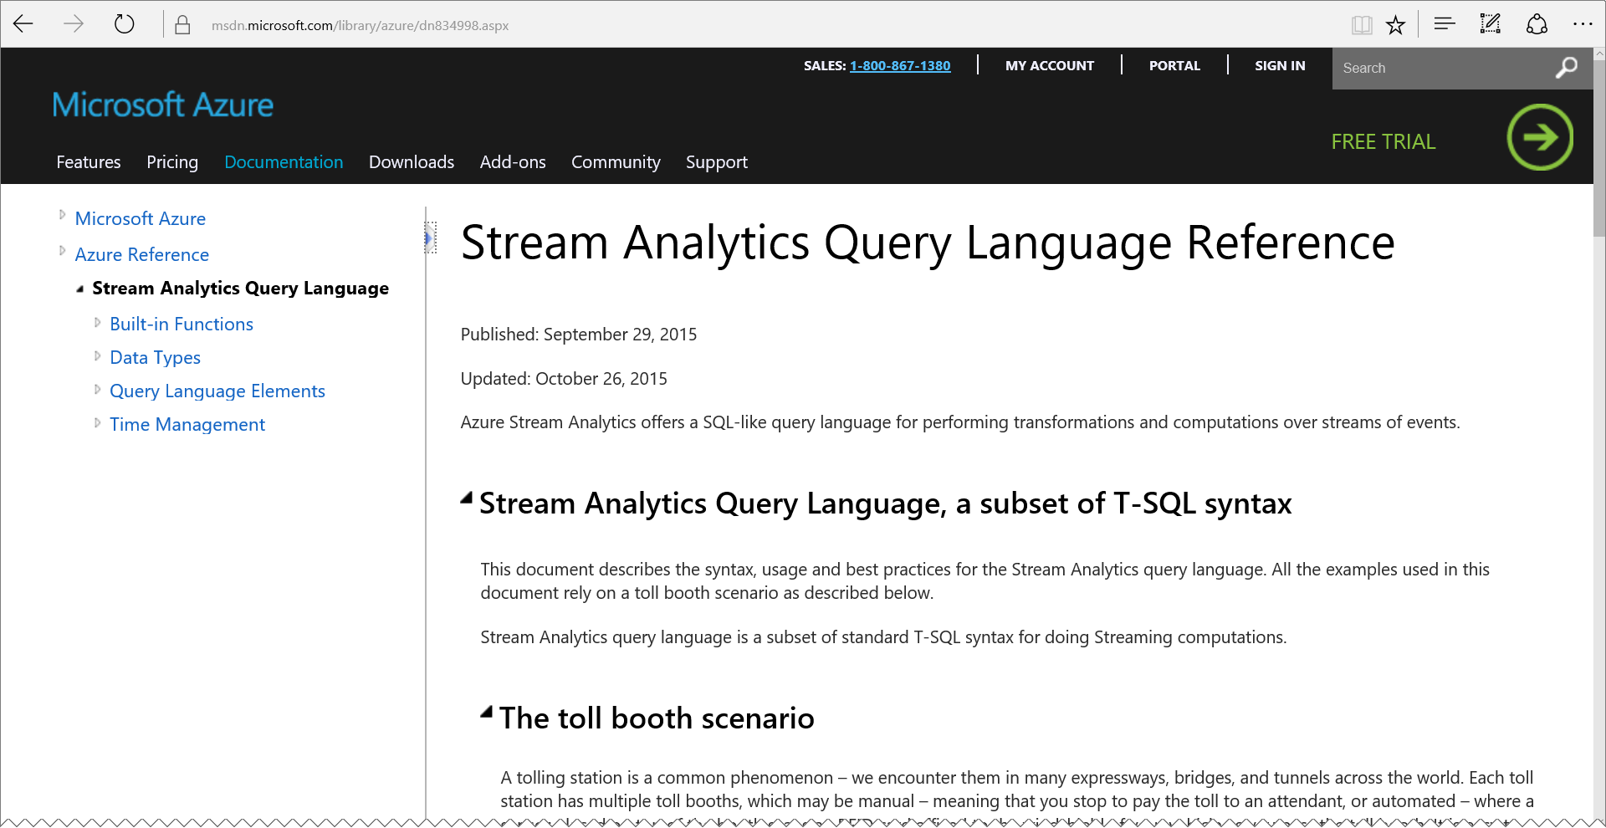
Stream analytics queries
A Subset of T-SQL
Can take data in from either streams (Event Hubs) or static data (Blobs) or relational data (SQL Database)
Can join multiple streams. For example you could join event hub message data with relational data from a database
Can output data to a streams, static data, databases, or Power BI.
Has powerful windowing functions for creating aggregations over Tumbling, Hopping or Sliding time windows
https://msdn.microsoft.com/library/azure/dn834998.aspx

Slide 70
Reporting with Power BI

Slide 71
Solution ARCHITECTURE
<name>data
Power BI Data Set
Send
<name>job
Stream Analytics Job
<name>ns Service Bus Namespace
Receive
Logging
<name>hub
Event Hub
<name>storage
Storage Account
SEND
PublishToEventHub Webhook

Slide 72
Solution ARCHITECTURE
<name>data
Power BI Data Set
Send
<name>job
Stream Analytics Job
<name>ns Service Bus Namespace
Receive
Logging
<name>hub
Event Hub
<name>storage
Storage Account
SEND
PublishToEventHub Webhook
Receive
“NodeReceiver”
Node.JS Receiver App

Slide 73
Particle photon weather station Part 5 of 6: RECEIVING EVENTS with Node.js
Particle Photon + DHT11 Sensor + Azure + Power BI + Node.js + .NET = AWESOME

Slide 74
Grab the slides & code:
http://aka.ms/ppws

Slide 75
Solution ARCHITECTURE
<name>data
Power BI Data Set
Send
<name>job
Stream Analytics Job
<name>ns Service Bus Namespace
Receive
Logging
<name>hub
Event Hub
<name>storage
Storage Account
SEND
PublishToEventHub Webhook
Receive
Receive
ChkPt
“NodeReceiver”
Node.JS Receiver App
“DotNetReceiver”
.NET C# Console App Receiver

Slide 76
Solution ARCHITECTURE
<name>data
Power BI Data Set
Send
<name>job
Stream Analytics Job
<name>ns Service Bus Namespace
Receive
Logging
<name>hub
Event Hub
<name>storage
Storage Account
SEND
PublishToEventHub Webhook
Receive
“NodeReceiver”
Node.JS Receiver App

Slide 77
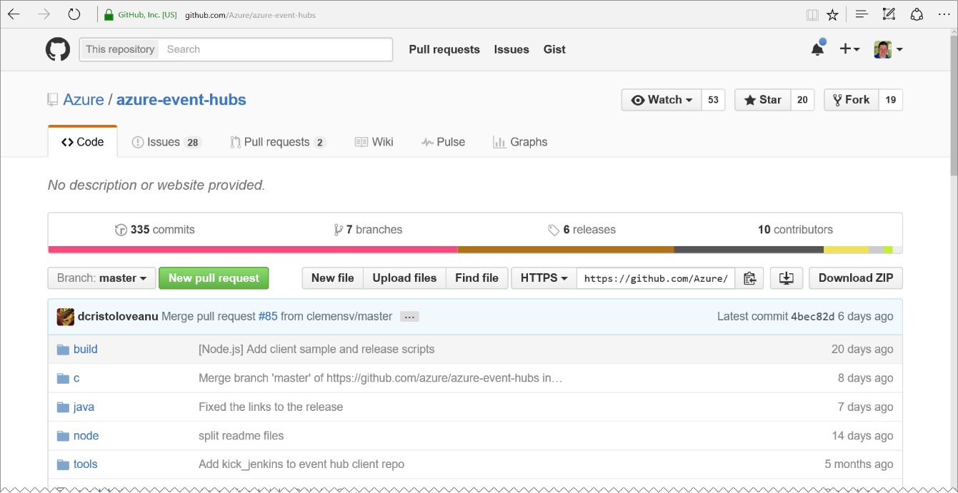
Azure-event-hubs repository
Azure Event Hub clients for
C
Java
Node.js
We’ll be using the “Node” client implementation in the upcoming demo.
https://github.com/Azure/Azure-event-hubs

Slide 78
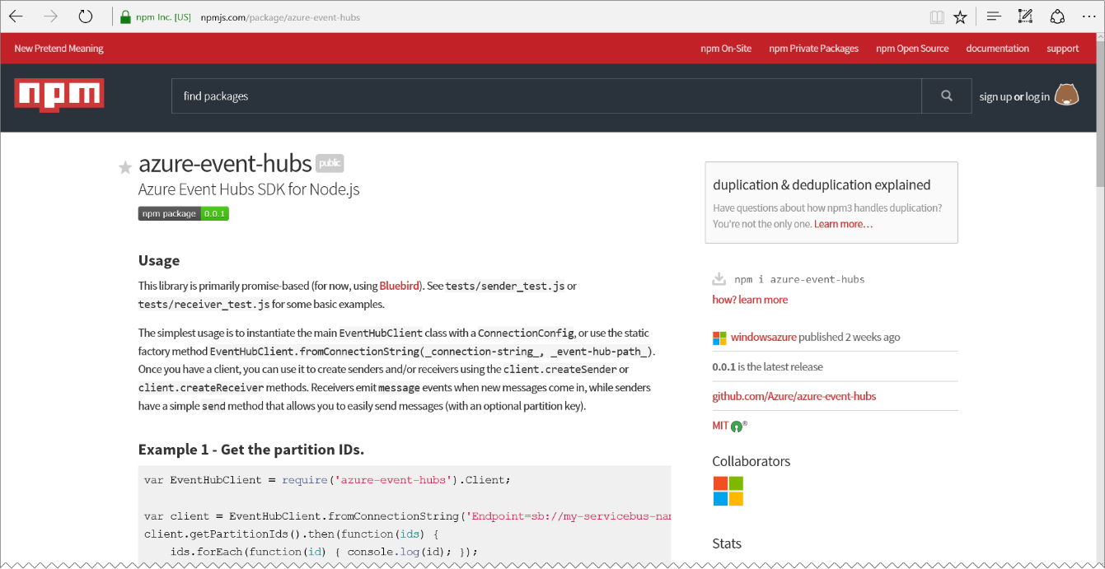
Azure-event-hubs NPM PACKAGE
Simplifies adding the Azure-Event-Hubs functionality to your Node packages
Depends on the Bluebird package’s promise implementation for async operations
npm install Bluebird
npm install Azure-Event-Hubs
https://www.npmjs.com/package/azure-event-hubs

Slide 79
Groking the node code
// Copyright (c) Microsoft. All rights reserved.
// Licensed under the MIT license. See LICENSE file in the project root for full license information.
'use strict';
var Promise = require('bluebird');
var EventHubClient = require('azure-event-hubs').Client;
// The Event Hubs SDK can also be used with an Azure IoT Hub connection string.
// In that case, the eventHubPath variable is not used and can be left undefined.
var connectionString = '[Event Hubs Connection String]';
var eventHubPath = '[Event Hub Path]';

Slide 80
Groking the node code
var sendEvent = function (eventBody) {
return function (sender) {
console.log('Sending Event: ' + eventBody);
return sender.send(eventBody);
};
};
var printError = function (err) {
console.error(err.message);
};
var printEvent = function (ehEvent) {
console.log('Event Received: ');
console.log(JSON.stringify(ehEvent.body));
console.log('');
};

Slide 81
Groking the node code
var client = EventHubClient.fromConnectionString(connectionString, eventHubPath);
var receiveAfterTime = Date.now() - 5000;
client.open()
.then(client.getPartitionIds.bind(client))
.then(function (partitionIds) {
return partitionIds.map(function (partitionId) {
return client.createReceiver(
'$Default', //Consumer Group Name
partitionId, //Current Partition ID being setup
{ 'startAfterTime': receiveAfterTime } //Start offset
).then(function (receiver) {
receiver.on('errorReceived', printError);
receiver.on('message', printEvent);
});
});
})

Slide 82
Groking the node code
// The send commands have been commented out since we want to just receive
// messages from the Photon sender, but you can see how you could use this code
// to send messages as well..
// .then(client.createSender.bind(client))
// .then(sendEvent('foo'))
.catch(printError);

Slide 83
Receiving Events Hub Messages with Node.js

Slide 84
Solution ARCHITECTURE
<name>data
Power BI Data Set
Send
<name>job
Stream Analytics Job
<name>ns Service Bus Namespace
Receive
Logging
<name>hub
Event Hub
<name>storage
Storage Account
SEND
PublishToEventHub Webhook
Receive
“NodeReceiver”
Node.JS Receiver App

Slide 85
Solution ARCHITECTURE
<name>data
Power BI Data Set
Send
<name>job
Stream Analytics Job
<name>ns Service Bus Namespace
Receive
Logging
<name>hub
Event Hub
<name>storage
Storage Account
SEND
PublishToEventHub Webhook
Receive
Receive
ChkPt
“NodeReceiver”
Node.JS Receiver App
“DotNetReceiver”
.NET C# Console App Receiver

Slide 86
Particle photon weather station Part 6 of 6: RECEIVING EVENTS with C#
Particle Photon + DHT11 Sensor + Azure + Power BI + Node.js + .NET = AWESOME

Slide 87
Grab the slides & code:
http://aka.ms/ppws

Slide 88
Solution ARCHITECTURE
<name>data
Power BI Data Set
Send
<name>job
Stream Analytics Job
<name>ns Service Bus Namespace
Receive
Logging
<name>hub
Event Hub
<name>storage
Storage Account
SEND
PublishToEventHub Webhook
Receive
Receive
ChkPt
“NodeReceiver”
Node.JS Receiver App
“DotNetReceiver”
.NET C# Console App Receiver

Slide 89
Solution ARCHITECTURE
<name>data
Power BI Data Set
Send
<name>job
Stream Analytics Job
<name>ns Service Bus Namespace
Receive
Logging
<name>hub
Event Hub
<name>storage
Storage Account
SEND
PublishToEventHub Webhook
Receive
Receive
ChkPt
“NodeReceiver”
Node.JS Receiver App
“DotNetReceiver”
.NET C# Console App Receiver

Slide 90
Sample code
https://azure.microsoft.com/en-us/documentation/articles/event-hubs-csharp-ephcs-getstarted/

Slide 91
Receiving Events Hub Messages with .NET

Slide 92
Solution ARCHITECTURE
<name>data
Power BI Data Set
Send
<name>job
Stream Analytics Job
<name>ns Service Bus Namespace
Receive
Logging
<name>hub
Event Hub
<name>storage
Storage Account
SEND
PublishToEventHub Webhook
Receive
Receive
ChkPt
“NodeReceiver”
Node.JS Receiver App
“DotNetReceiver”
.NET C# Console App Receiver

Slide 93
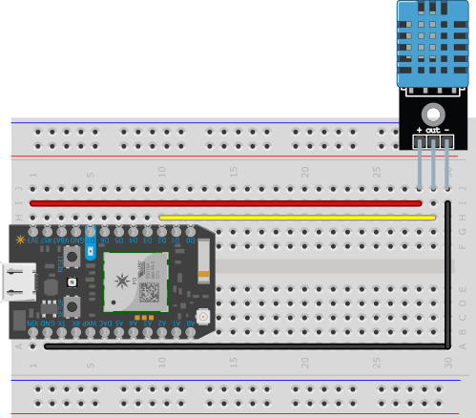
Architecture overview
PublishWeather Web Hook
DeviceHub Event Hub
PowerBIDump Stream Analytics Job
WeatherData Power BI Data Set

Slide 94
Architecture overview
PublishWeather Web Hook
DeviceHub Event Hub
PowerBIDump Stream Analytics Job
SensorData Power BI Data Set

Slide 95
Power BI LOGO

Slide 96
IoT Logo

Slide 97
arduino

Slide 98
GALILEO BOARD

Slide 99
RASPBERRY PI

Slide 100
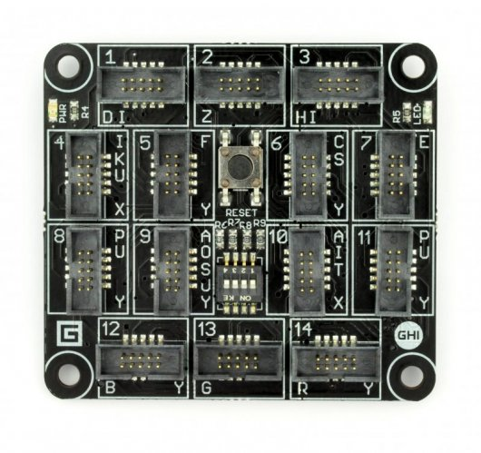
FEZ SPIDER MAIN BOARD

Slide 101
Sparkfun weather shield

Slide 102
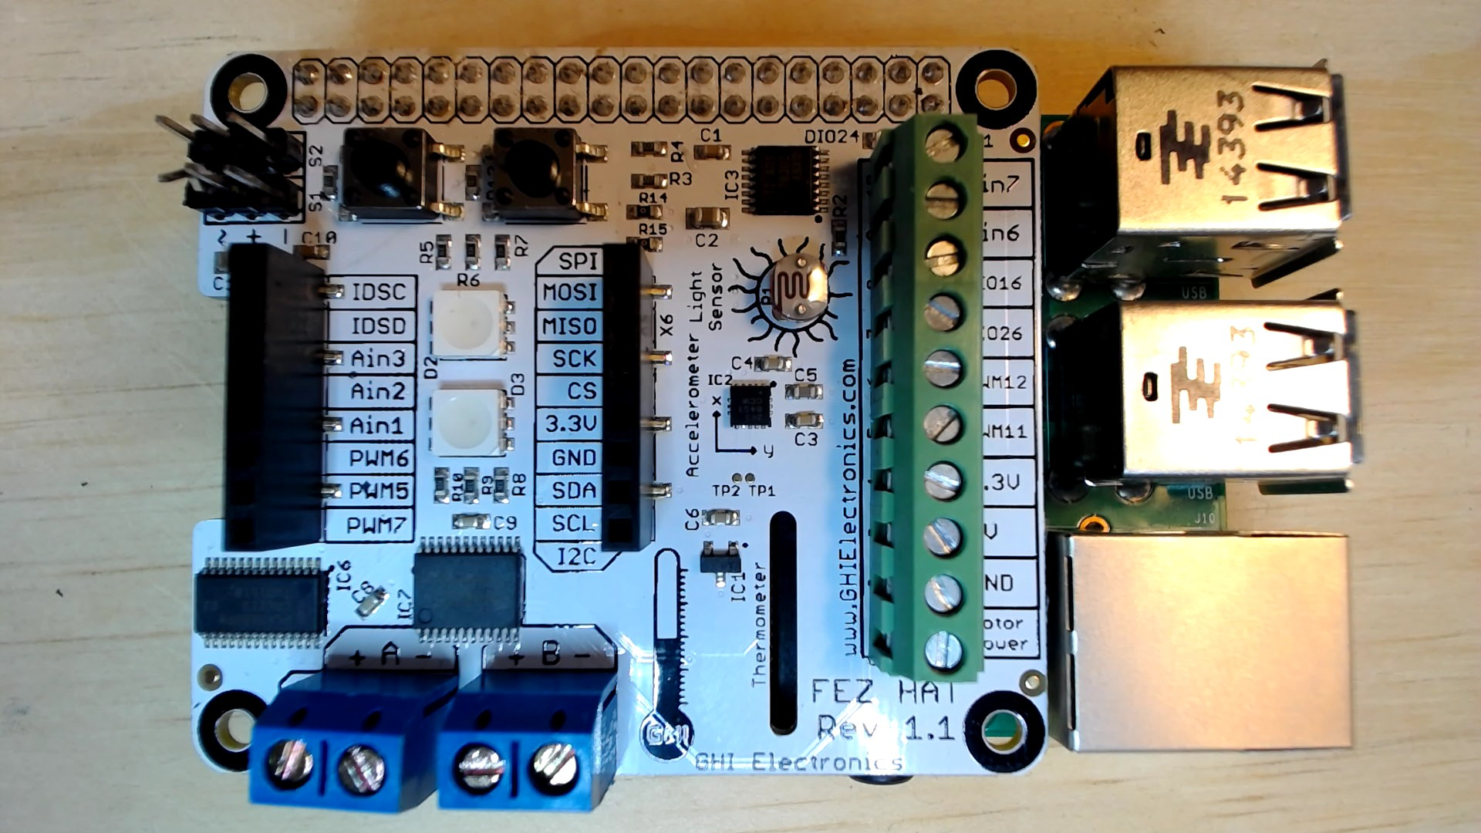
FEZ HAT

Slide 103
Connect the dots azure icons
Event Hubs
Stream Analytics
Storage
(
Azure
Microsoft Azure
Web App
Service Bus
)
Storage blob
Storage table
SQL database
HDInsight
Machine
(
Learning
GitHub code
Git repository
generic
)

Slide 104
LEDs

Slide 105
Resistors
220Ω
1st Digit
2nd Digit
Multiplier
Tolerance
Color | Name | 1st Digit | 2nd Digit | Multiplier | Tolerance
 | Black | 0 | 0 | X1
 | Brown | 1 | 1 | X10 | 1%
 | Red | 2 | 2 | X100
 | Orange | 3 | 3 | X1,000
 | Yellow | 4 | 4 | X10,000
 | Green | 5 | 5 | X100,000
 | Blue | 6 | 6 | X1,000,000
 | Violet | 7 | 7
 | Grey | 8 | 8
 | White | 9 | 9
 | Gold |  |  | X0.1 | 5%
 | Silver |  |  | X0.01 | 10%
330Ω
10KΩ

Slide 106
cables

Slide 107
More cables and adapters

Slide 108

LEDs
Anode (+)
Cathode (-)
Flat Edge
Small Post
Big Post
Long Leg
Short Leg
Vcc (+)
GND

Slide 109
LEDs

Slide 110
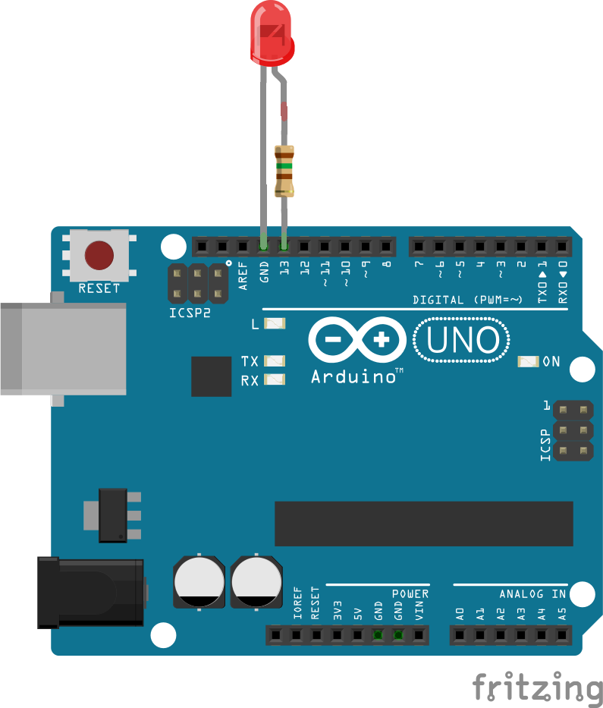

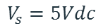
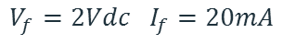
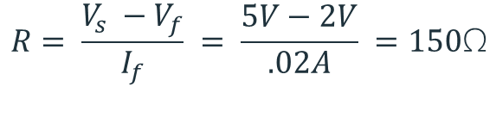
Current limiting resistors
Providing more current than an LED is rated for can destroy the LED. To prevent that, you should use a “Current Limiting” resistor.
To calculate the value of the resistor you need to know the supply voltage (Usually 5V on the Arduino Uno), and the LEDs rated Forward Voltage (the voltage drop across the LED) and Forward Current (the maximum current the LED can handle).
$$V_{f}=2Vdc I_{f}=20mA$$
$$Resistor Value (R)= \frac{Supply Voltage \left(V_{s}\right)−LED Forward Voltage (V_{f}) }{LED Forward Current (I_{f})}$$
$$V_{s}=5Vdc$$
$$R= \frac{V_{s} −V_{f}}{I_{f}} = \frac{5V−2V}{.02A} =150\text{Ω}$$
The Arduino Uno has a built in current limiting resistor on Pin 13. If you use Pin 13 to power your LED you can use it without a separate resistor.

Slide 111
Resistors
220Ω
1st Digit
2nd Digit
Multiplier
Tolerance
Color | Name | 1st Digit | 2nd Digit | Multiplier | Tolerance
 | Black | 0 | 0 | X1
 | Brown | 1 | 1 | X10 | 1%
 | Red | 2 | 2 | X100
 | Orange | 3 | 3 | X1,000
 | Yellow | 4 | 4 | X10,000
 | Green | 5 | 5 | X100,000
 | Blue | 6 | 6 | X1,000,000
 | Violet | 7 | 7
 | Grey | 8 | 8
 | White | 9 | 9
 | Gold |  |  | X0.1 | 5%
 | Silver |  |  | X0.01 | 10%
330Ω
10KΩ

Slide 112
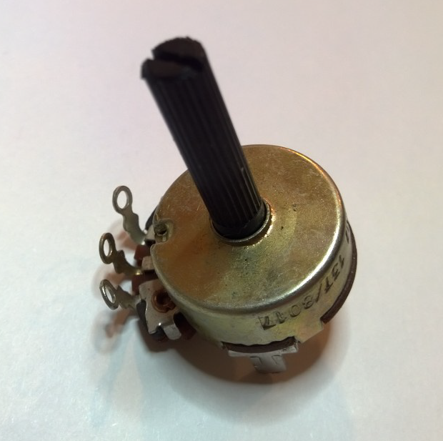
Potentiometer – variable resistor

Slide 113
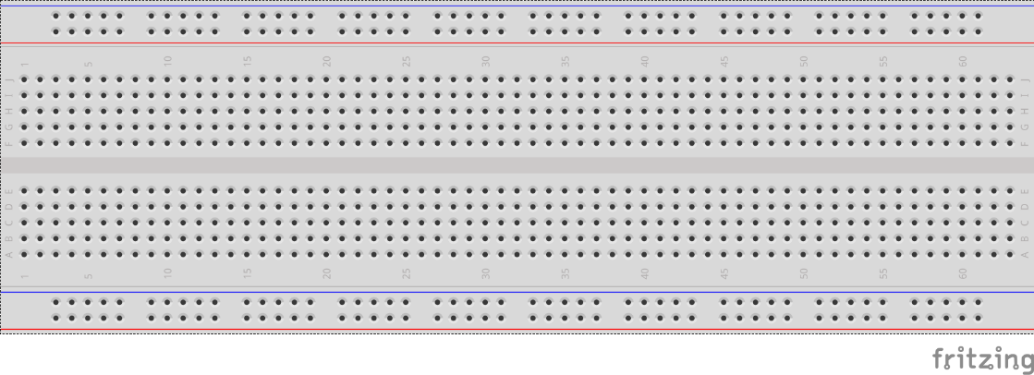
breadboards
Breadboards offer a great way to prototype circuits. The provide a number of “buses” for connecting both power and components.
Power buses run the entire horizontal length
Component buses give you easy ways to connect pins together

Slide 116
Micro SD Cards
Font: Segoe UI Semibold

